Slide 1
Requirements Management and Traceability
Muhammad Usman Shahid
Notes:
Analysis – The decomposition of a problem into smaller more manageable parts.
Synthesis – Building a solution from authenticated parts.
‹#›

Slide 2
Contents
A bit about requirements
Some definitions
Define requirements management and traceability
Trace models
Some examples
Personal experiences
Q & A
*
‹#›

Slide 3
Requirements
Why do we bother with requirements?
So we know what we are doing
So we know why we are doing it
So we know if we are doing it right
So we know if we are doing the right thing
So that we can assess the costs to do the work
Etc ..
*
‹#›
Notes:
‹#›

Slide 4
What Is A Requirement?
A requirement is NOT just a line of text.
A requirement is some ‘thing’ that allows us to verify that the system implementation is going to be ‘correct’.
A requirement is verifiable.
It may be described by text.
It may be described with images.
It has a number of attributes that allow it to be verified, such as boundary conditions, states under which the requirement is in effect, input or triggering data, expected output or results, timing.
Example requirements specification languages Z, VDM, how about OCL?
*
‹#›

Slide 5
Requirements Management
Requirements management is the procedures and guidelines for ensuring that requirements are:
Satisfied – Did we capture all the business needs
Feasible – Can we do this within budget and resource constraints
Justified – Do we need to be doing this
Consistent – Are we doing this right
Testable – Are we doing the right thing
Etc (For example, organized such that we can find requirements).
*
‹#›

Slide 6
Traceability Definition
The ability to identify and document the lineage of each requirement, including its derivation (backward traceability), its allocation (forward traceability), and its relationship to other requirements.
*
‹#›

Slide 7
What is Traceability?
Traceability is the act of connecting a requirement to( ), from( ) or across( ), any other artifact produced during development, including:
Business need – Connects to system requirements
System Requirement – Connects to business needs, to design modules and test cases
Design module – Connects to system requirements and to test cases
Test case – Connects to system requirements and to design modules.
*
‹#›
Notes:
Connection can be by containment, DFDs for example, or Epics.
‹#›

Slide 8
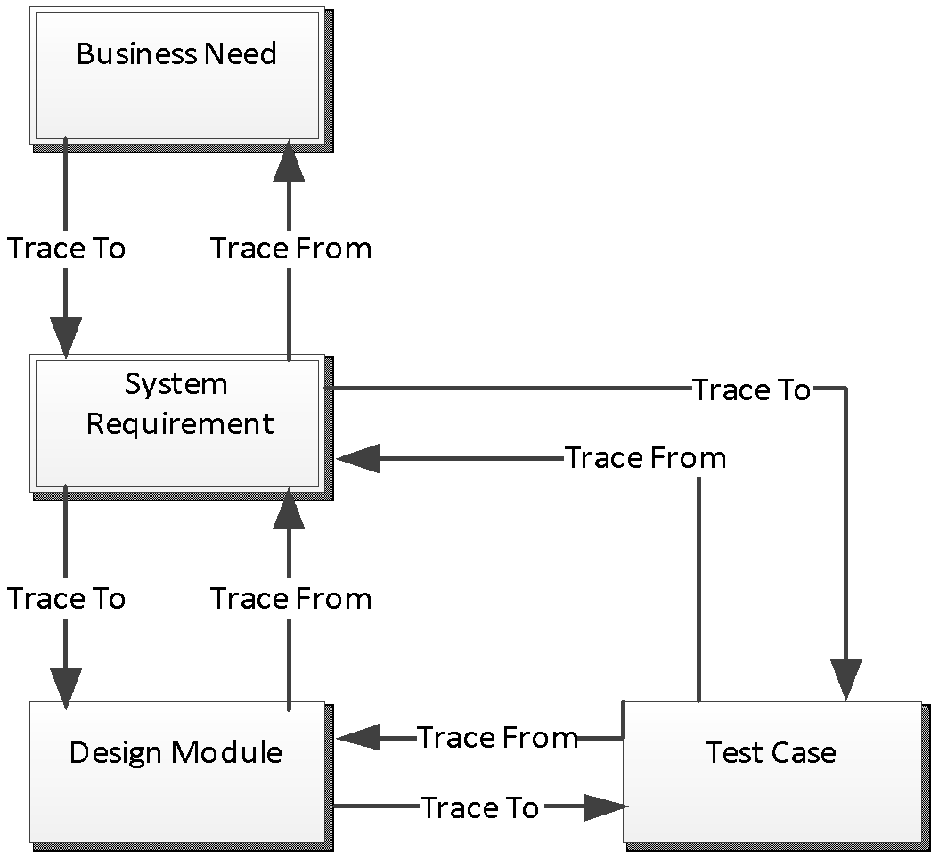
Simple Traceability Tree
*
‹#›

Slide 9
What Do We Get From Simple Traceability?
Managing the lifecycle of a set of requirements.
Allows us to identify the origin of each requirement.
Tracks the reason for every change made to the requirement.
Allows justification for the implementation and deployment of a requirement.
Ensures that implementation and deployment satisfies the requirements.
*
‹#›

Slide 10
Types Of Requirement
Requirements come in many flavors:
Functional requirements – Describe a feature that can be observed over a period of time.
Non-Functional requirement – Impose restrictions upon functional requirements in terms of:
timing, security, business rules, hardware restrictions, technology constraints, design constraints, and many others.
Business Rule – Restriction on a business need.
*
‹#›

Slide 11
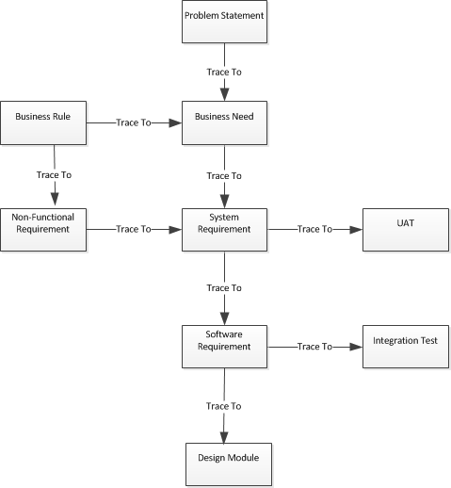
More Complicated Traceability Tree
*
‹#›
Notes:
This is a typical MIL-STD traceability tree.
User Acceptance Testing (UAT)
‹#›

Slide 12
What Can We Get From More Complicated Traceability?
Using traceability to prove requirements are:
Justified – Trace the system requirements from the business needs
Satisfied – Trace the business needs to the system requirements
Feasible – Trace non-functional requirements and functional requirements
Testable – Trace the system requirements to the user acceptance test cases (user stories or use cases).
*
‹#›

Slide 13
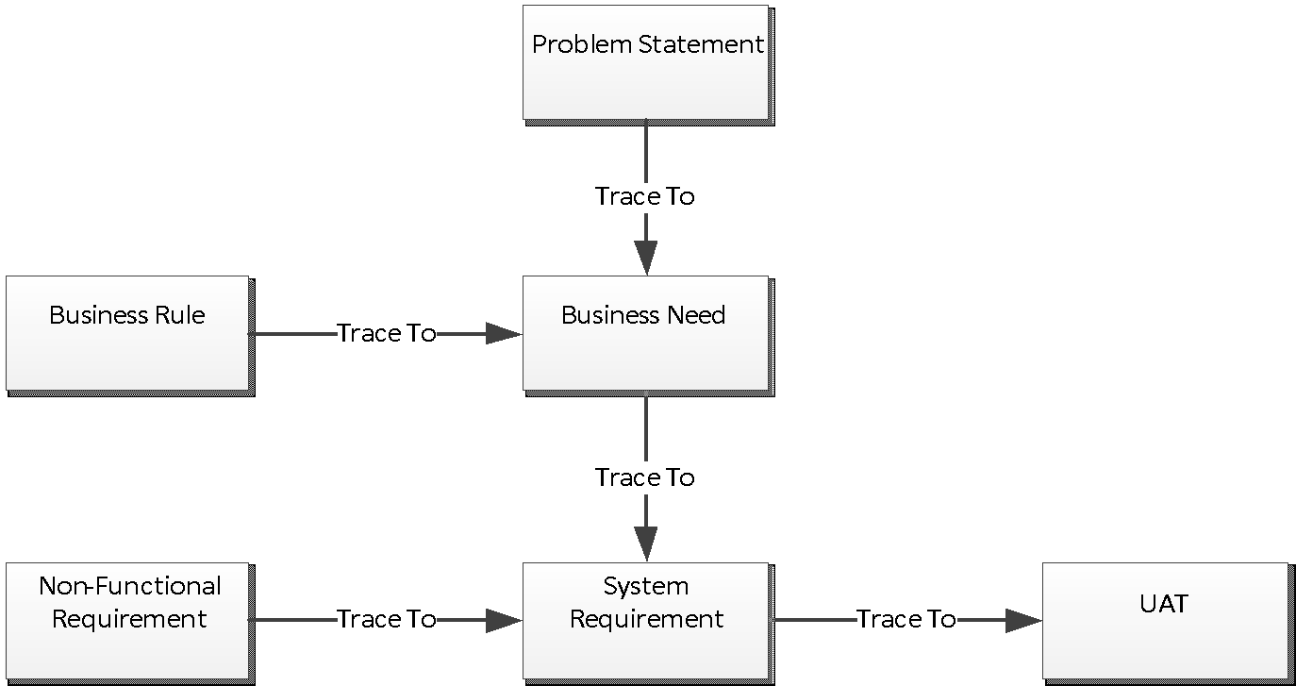
Realistic Traceability Tree
*
‹#›
Notes:
Why trace across – so that we are not duplicating information. Change in one place.
‹#›

Slide 14
Tools
Document (MS Word for example) – Commonly used to create the BFRD (Big Functional Requirements Document). Analysts start with a template and fill out each section with the relevant information. Traceability is performed by making reference to text in another section of the document.
Suitable for small projects with no more than ~20 system requirements, otherwise traceability becomes unmanageable and is abandoned before the document is complete.
Spreadsheet (MS Excel for example) – Is an improvement on a text document in that each requirement can be managed as a separate entity and traced to its location in the spreadsheet. Clutter is removed. Easier to manage requirements and reference them as they a moved.
Typically where the business needs are located. May be suitable for projects up to ~100 system requirements, but will become unmanageable since links are managed manually and there is no mechanism for automatically tracking broken links.
Requirements Management Tool (ReqPro or DOORS for example) - Using RM tools adds automation to spreadsheets and provides reporting capabilities for tracking broken or suspect traceability links.
Good for medium sized projects up to ~1000 or so system requirements, after which the manual maintenance becomes to great and traceability is gradually abandoned.
Modeling Tools (Rational, Enterprise Architect for example) - Allows graphical representation of traceability between requirements elements and design elements. Also test cases can be represented and linked via an interface to the testing tool.
Excellent way to represent traceability if the requirements are going to be modeled and the model is going to be maintained throughout the life of the project.
Online Shared Repository (SharePoint or Rally for example) – Much more flexible than Excel, but tool setup configuration and some maintenance is required.
Used for agile projects where the requirements are textual based and a simple traceability model is used.
*
‹#›

Slide 15
Example With Word
Business Needs
BN#1: business need text
Etc..
System requirements
SR#01: system requirement text [BN#1]
Non-Functional Requirements
Performance
Security
NFR#01: non-functional requirement text [SR#01]
*
‹#›

Slide 16
Example Using Excel
Requirement Id | Requirement | Trace From
BR:01 | Business requirement text | PS:1
SR:001 | System Requirement Text | BR:01
NFR:001 | Non-functional requirement text | SR:001
Test Case Id | Description | Trace From
Test Case #001 | Descriptive text | SR:001
*
‹#›

Slide 17
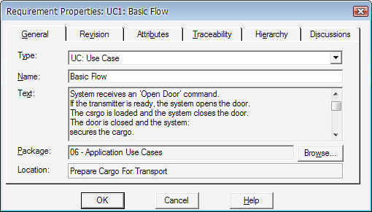
Requirements Management Tool (ReqPro)
*
‹#›

Slide 18
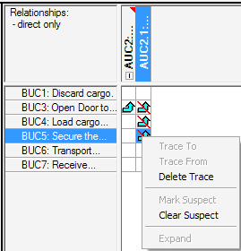
ReqPro Traceability Matrix
*
‹#›

Slide 19
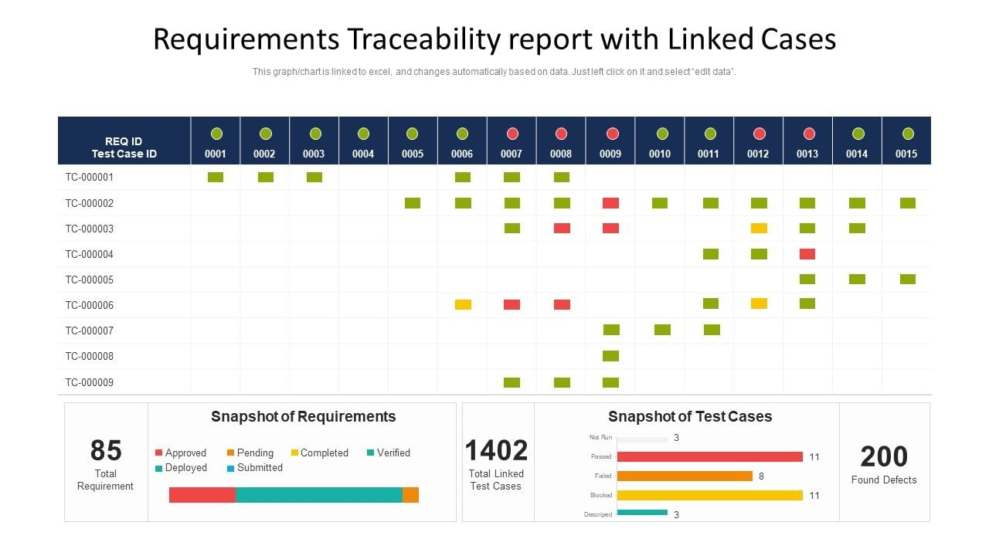
Diagraming Traceability
*
‹#›
Notes:
Allows for manageable partial traceability models
‹#›

Slide 20
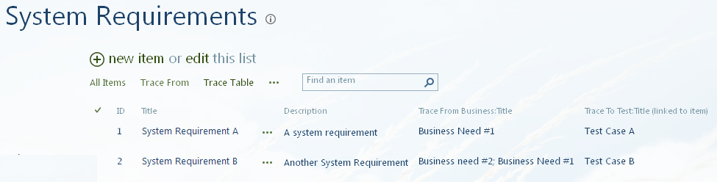
SharePoint Example
*
‹#›

Slide 21
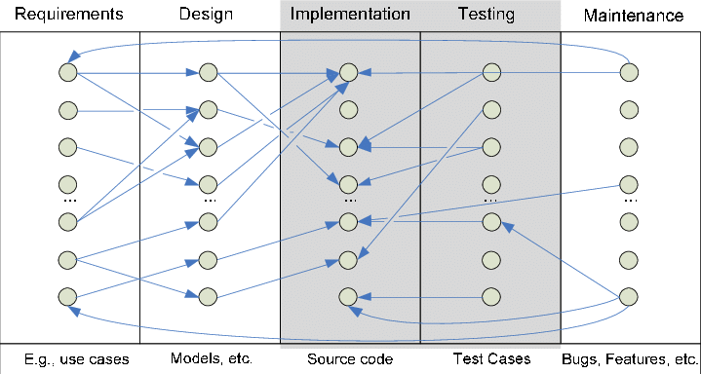
Traceability Link Graph
*
‹#›

Slide 22
Why Is Traceability So Hard?
Requirements do not trace 1 to many as we go down the tree. 1 requirement may trace to many parent requirements. (Rally.)
Requirements change, traceability breaks.
Manually intensive, even with the most complex of requirements management tools.
Traceability is a guessing game, it is never perfect.
Not understanding why we are performing traceability, why are we tracing this requirement?
More important project tasks. Traceability gets left behind and never catches up.
*
‹#›
Notes:
‹#›

Slide 23
Summary
Traceability is about linking one item to another to show a relationship (specifically one of those items is a requirement)
Traceability shows requirements that have no parent business need (not justified)
Traceability shows business needs that have no requirements (not satisfied)
Traceability allows a supplementary (non-functional) requirement to be linked to several functional system requirements, hence removing duplication.
Traceability links from requirements to test cases ensure correct validation of the requirements
Traceability links ensure that when a requirement changes, that all impacted items are identified. (Justify the cost to the business of making a change to the requirements.)
*
‹#›

Slide 24
Recommendations
Create a traceability tree model and enforce it. (Do not allow tracing between requirement types not specified in the model.)
Identify a level of detail to which it is necessary to trace requirements. (Epics vs user stories, Scrum example. Or use cases vs actions, RUP example.) Packaging requirements is a very simple way to maintain traceability.
Understand the benefit of each trace type in the model.
Understand the cost of maintaining the traceability model.
Is it necessary to maintain the traceability model throughout the whole lifecycle of the project, or is the a point at which diminishing returns on benefit make traceability no longer cost-effective?
Is it necessary to trace every requirement, or just the important ones?
Manual traceability is laborious and prone to mistakes. Automate the process as much as possible.
*
‹#›

Slide 25
References
Analysis Through Picture (Chapter 19)
Introduction to RequisitePro
Rally traceability links
Rational DOORS Next Generation
*
‹#›

